Slide 1
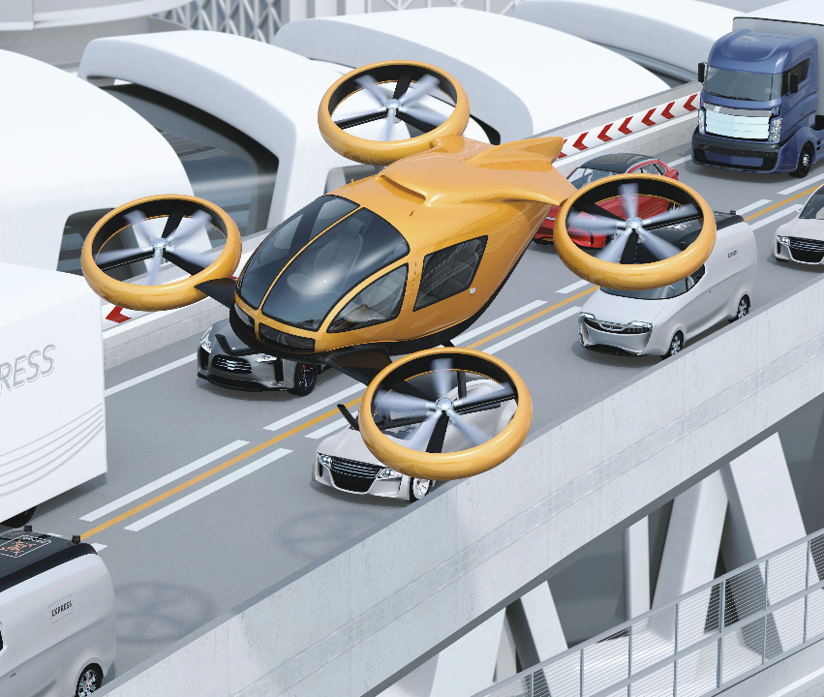
AIR AMBULANCE
Presented by :
KarthickPandiyan R
Ayyanar.S
Abdul Aziz M
Jegan.J
Guide:
Dr. Ayshathul Fouzia Abdul Gani

Slide 2
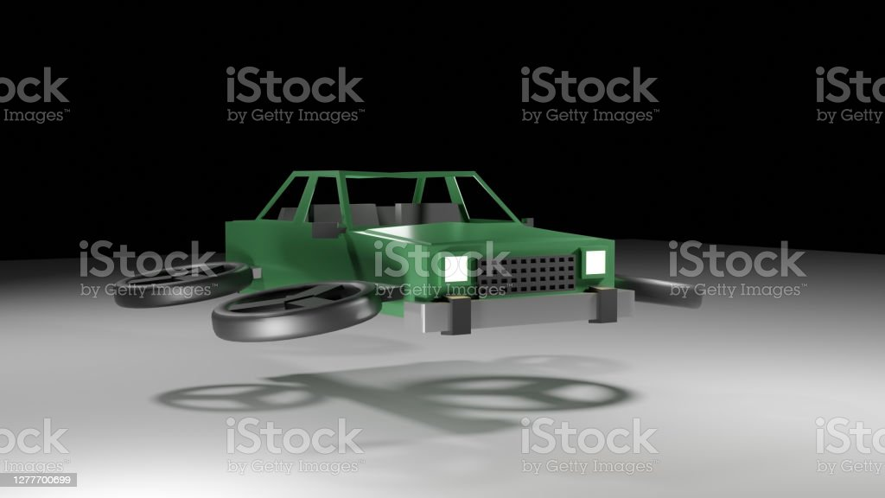
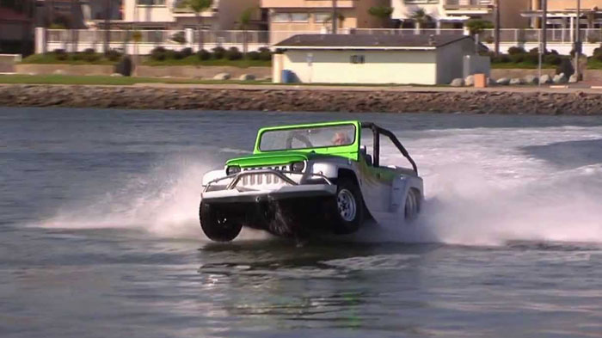
CONTENT
This ambulance can fly within the rules of the road and if the ambulance is unable to fly.
The ambulance can also navigate in the nearby water.

Slide 3
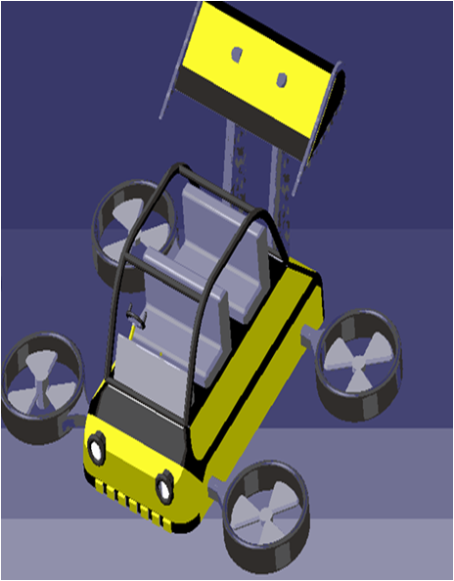
OBJECTIVE
The purpose of this work is to explore the use of air ambulance services as a means of providing rapid medical assistance to critically ill or injured patients in remote or inaccessible areas.
Here, we explore the advantages of using air ambulances, such as faster transport times, improved medical comfort and the ability to transport patients over long distances.
The idea proposed in this work uses drones and helium gas balloons to facilitate transport on land, water and air.

Slide 4
LITERATURE REVIEW
ØFlying Car Transportation System: Advances, Techniques, and Challenges has proposed a method Flying Car Design
• Take-off & landing (TOL) modes, pilot modes, operation modes, and power types, which are the methods related to the adaptability, flexibility & comfort, stability & complexity, and environmental friendliness of flying cars, respectively .
ØFLYING VEHICLE:
In the existing system, the vehicle can come down with the help of a parachute to assist the drone to come out and help it fly whenever the drone is in one place.
•In the proposed system, the vehicle can move on land, can fly up to a certain distance with the help of a drone when and where required, and can float on water with the help of helium gas.(airbags).

Slide 5
PROPOSED WORK
We proposed that our work is based on the idea of flying vehicle using of Drone mechanism to lifted up while stuck in the traffic on the roadways.
Also, there may be a Floating mechanism by using air balloons of an object floats when the weight force on the object is balanced by the upward push of the water on the object.
These above two mechanisms are to be implemented in our project work to get completed successfully.

Slide 6
METHODOLOGY
when the road is jammed, the rod installed in this vehicle in all four directions will lift the vehicle, and when it is lifted, the direction of the four wheels will change.
Helium gas installed on all sides of the vehicle reduces the weight of the vehicle.
A helium gas balloon attached to the bottom of the vehicle makes the vehicle buoyant when the vehicle is submerged for a certain distance.
When the front wheel of the vehicle rises up to 20 degrees and the rear wheel rises up to 30 degrees, it reaches the destination easily with the help of a boat mounted on the wheel of the vehicle.

Slide 7
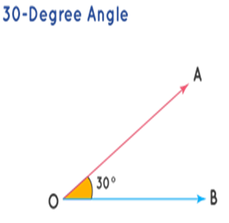
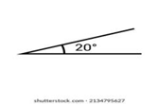
Wheel Position water
Rear wheel Position Front wheel Position

Slide 8
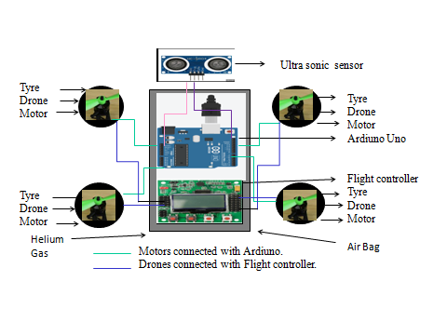
BLOCK DIAGRAM

Slide 9
COMPONENTS
Drone motor
Helium gas
Thermocol
Aluminium sheet
Air Bags
Flight control
Jumber wire
Battery
ESC Controller
Brushless Motor
Ardiuno

Slide 10
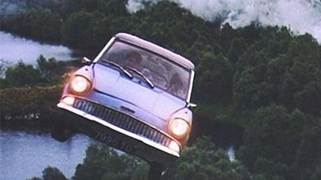
Helium gas
Helium gas is also used to float an object in air.
By injecting this helium gas, objects of any size can be reduced from 100% to 30%.

Slide 11
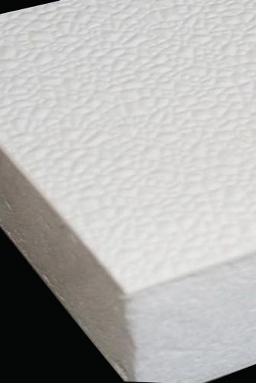
Thermacol usage
As this vehicle rises, it is more likely to heat up due to solar heat.
Thermacol is very helpful in reducing heat.
It also helps the vehicle to rise up.

Slide 12
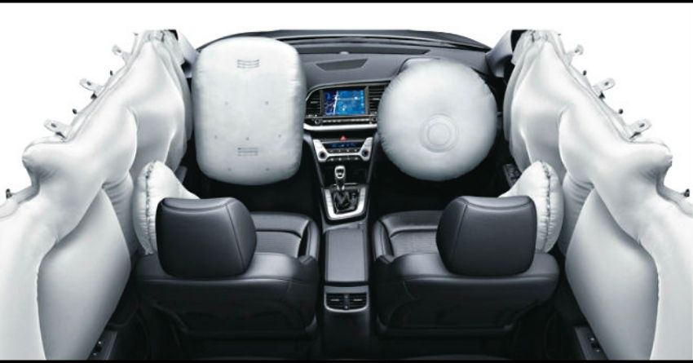
Air Bags
This is very helpful for lifting the vehicle.
The inflated helium gas of this air bag is very helpful for flying and floating.

Slide 13
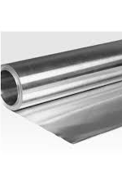
Aluminium Sheet
Aluminum is the second most common metal in the world.
By using an aluminum sheet across the side of the vehicle, the weight of the vehicle is reduced.

Slide 14
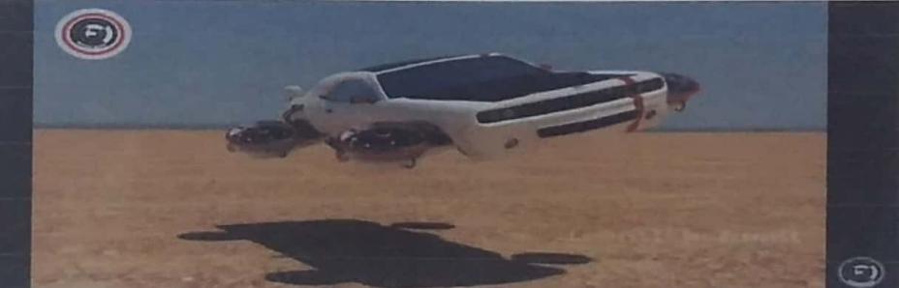
Drone Setup
The most important thing for this vehicle to get up and running is the drones.
These drones are mounted on the side of the wheel.
The wheel is also filled with helium gas with the help of this is called work.

Slide 15
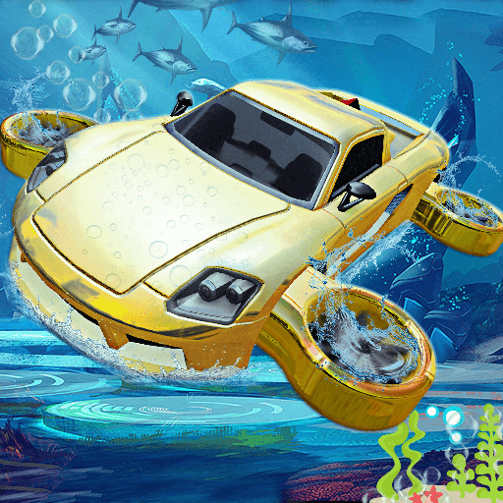
Water riding drone setup
A helium gas balloon attached to the bottom of the ambulance keeps the ambulance buoyant when submerged in water.
The rear wheel mounted on the ambulance is raised by 30° and the ambulance is driven backwards.
Ambulance has a 20 degree bank on the front wheel.
Thus changing the position leads to the destination and reaches the destination.

Slide 16
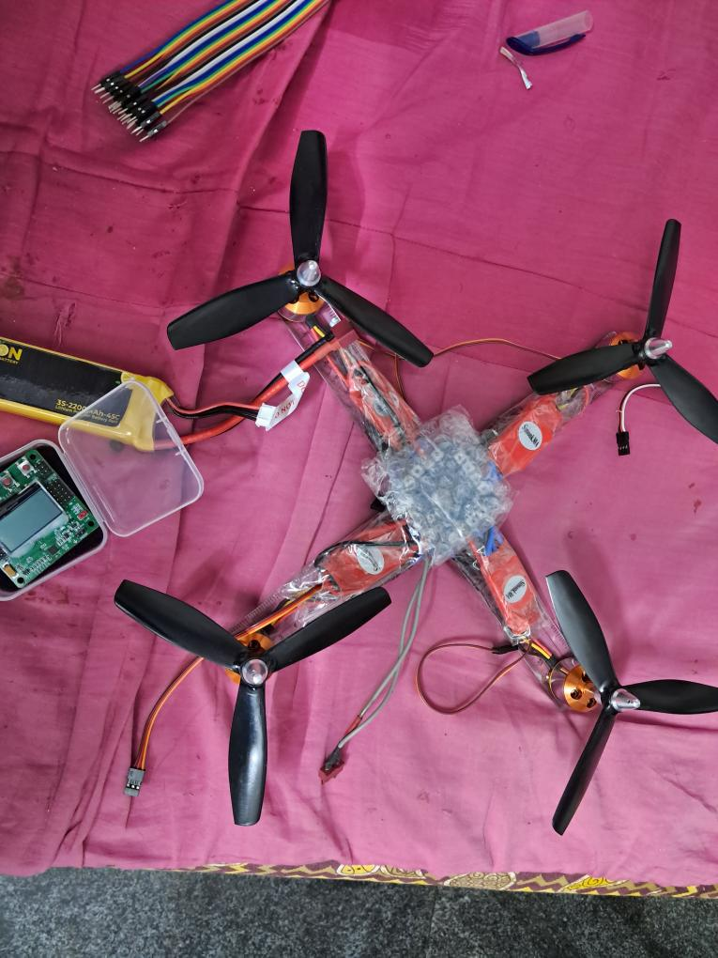
SIMULATED
A protype of the ambulance will be designed and developed.
Tinkercad .–this is used for simulate and create a code for Arduino sensors.

Slide 17
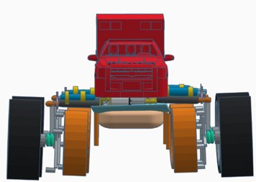
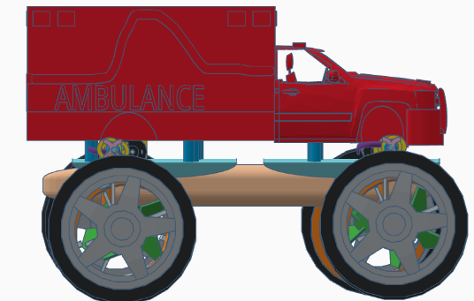
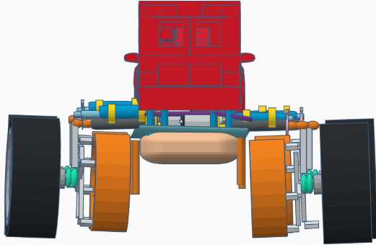
Run way Position(https://www.tinkercad.com/things/dCZfXgpVRoB-shiny-juttuli/edit)

Slide 18
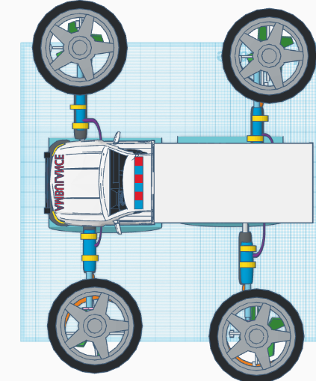
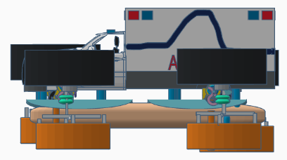
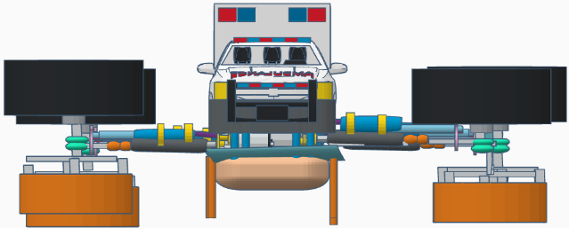
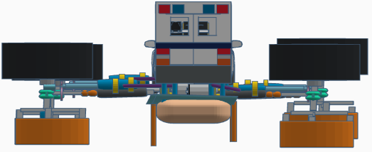
Flying Position(https://www.tinkercad.com/things/5ixAR3H1opu-copy-of-ambulance/edit)

Slide 19
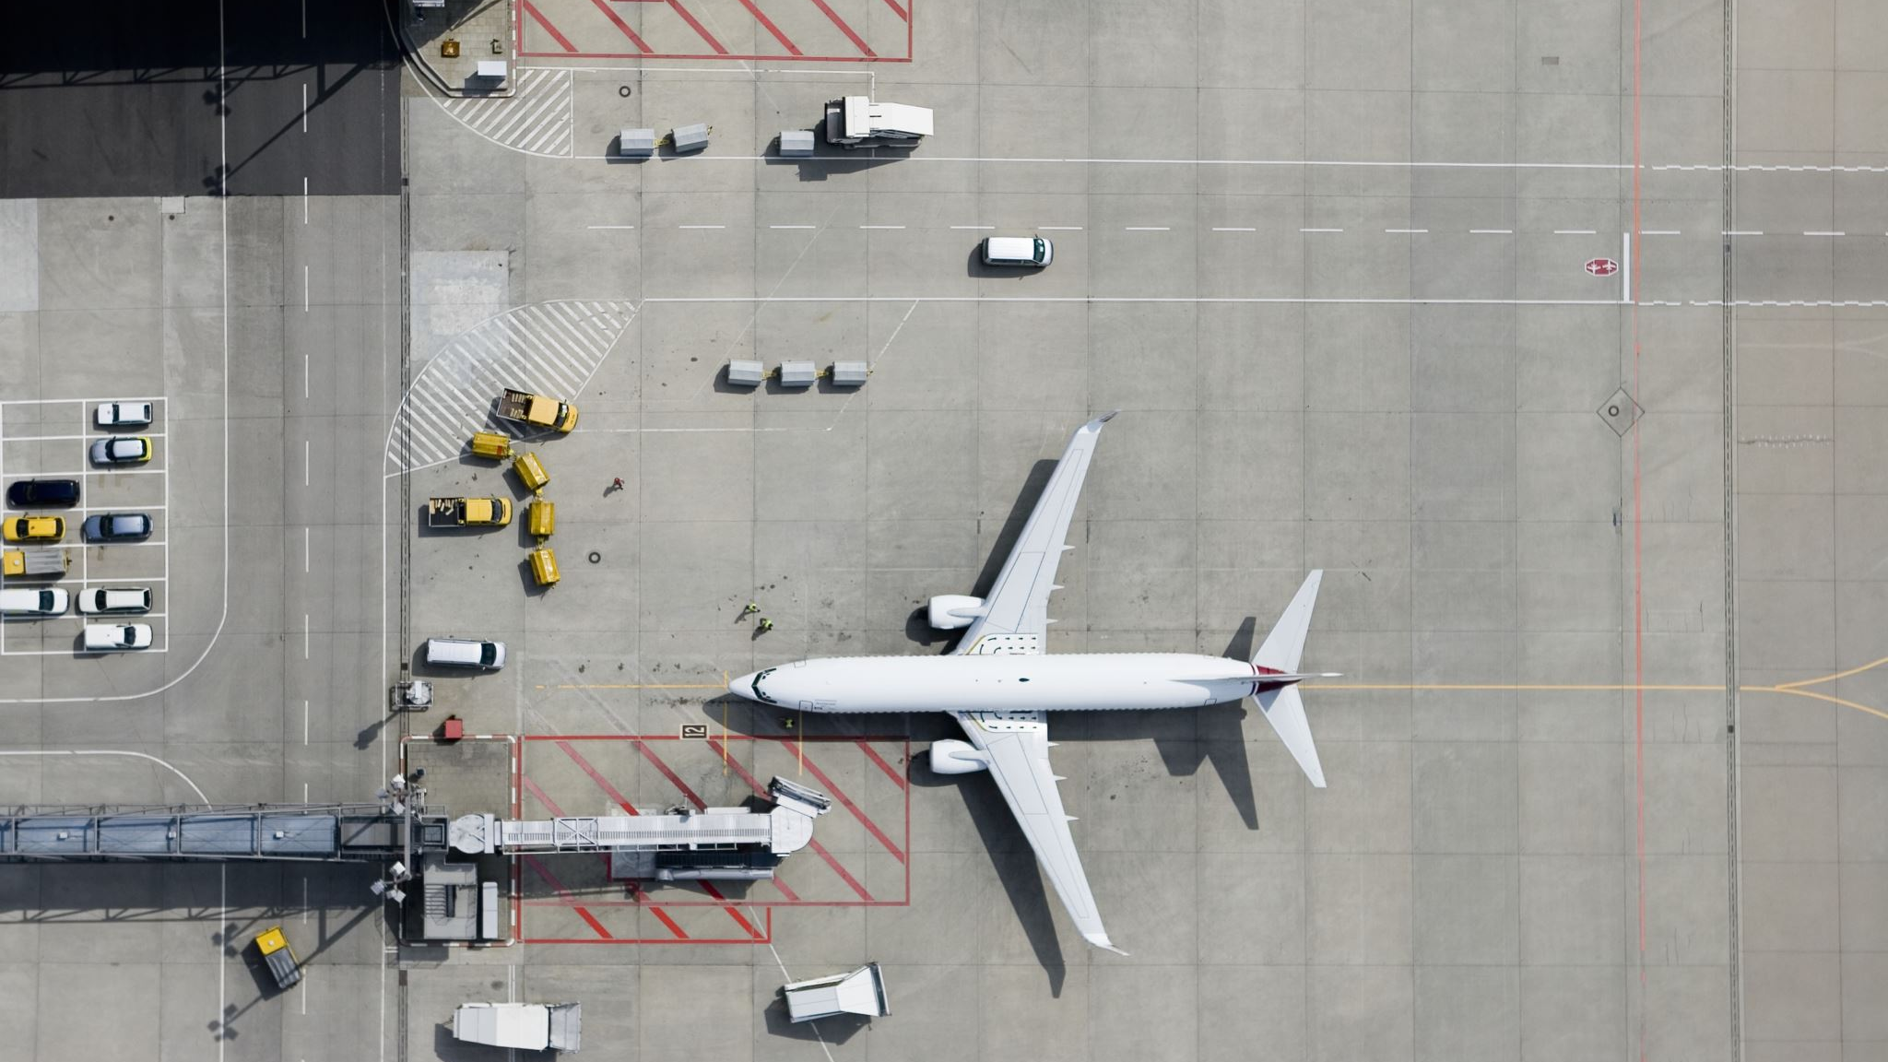
WORKING PRINICIPLE
The average weight of an ambulance vehicle is up to four tonnes. This can be reduced to three or two days when removing unnecessary parts.
The drone motor installed in this vehicle has a capacity of 18000 rpm. This makes it easy to lift the vehicle.
The vehicle can hover up to 30 or 40 feet with the help of a drone and helium gas.
The GSM model installed in this vehicle detects the traffic signal at a short distance and adapts accordingly.
The vehicle is as fast as other ambulances on the road, can reach speeds of 30 or 40 km/h on an incline, and the same speed on water.

Slide 20

ADVANTAGE
This vehicle is unlike any other vehicle capable of moving on water and air.
This can save many lives quickly.

Slide 21

DISADVANTAGE
This vehicle cannot fly very high.

Slide 22
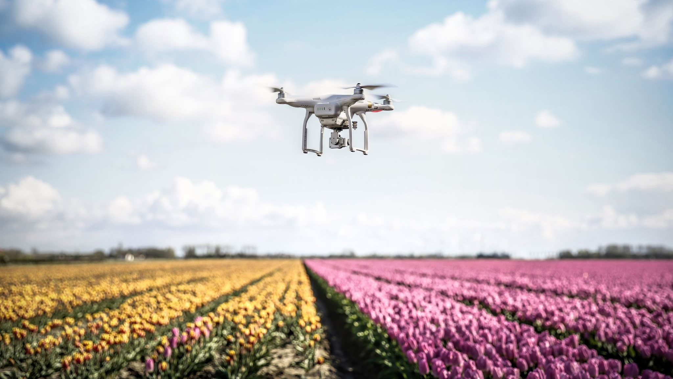
CONCLUSION
This project can save people's lives quickly.
The drone can move in any direction with the help of helium gas

Slide 23
